Slide 1
INFO 656-01 Fall 2020 Neural Networks
Week 10
Amir Imani

Slide 2
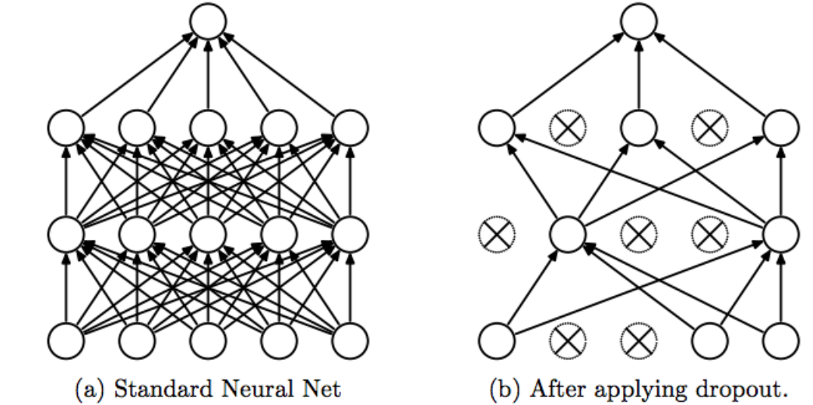
Drop-out Regularization
Deep learning neural networks are likely to quickly overfit
Implemented per layer
Allows using deeper and larger models
Notes:
Dropout regularization is a generic approach that can be used with all network types.
Dropout is not used after training when making a prediction with the fit network.
It is common for lager networks. In fact, a large network (more nodes per layer) may be required as dropout will probabilistically reduce the capacity of the network.

Slide 3
Batch Normalization
A technique for training (very) deep neural networks that standardizes the inputs to a layer for each mini-batch.
Instead of just normalizing the inputs to the network, we normalize the inputs to layers within the network.
Applied either to the activations of a prior layer or inputs directly
Benefits: Faster training, higher learning rates, easier weights initialization, more viable activation functions, deeper networks, …
Notes:
Training deep neural networks with tens of layers is challenging as they can be sensitive to the initial random weights and configuration of the learning algorithm.
One possible reason for this difficulty is the distribution of the inputs to layers deep in the network may change after each mini-batch when the weights are updated. This can cause the learning algorithm to forever chase a moving target.
Networks train faster — Each training iteration will actually be slower because of the extra calculations during the forward pass and the additional hyperparameters to train during back propagation. However, it should converge much more quickly, so training should be faster overall.
Allows higher learning rates — Gradient descent usually requires small learning rates for the network to converge. And as networks get deeper, their gradients get smaller during back propagation so they require even more iterations. Using batch normalization allows us to use much higher learning rates, which further increases the speed at which networks train.
Makes weights easier to initialize — Weight initialization can be difficult, and it’s even more difficult when creating deeper networks. Batch normalization seems to allow us to be much less careful about choosing our initial starting weights.
Makes more activation functions viable — Some activation functions do not work well in some situations. Sigmoids lose their gradient pretty quickly, which means they can’t be used in deep networks. And ReLUs often die out during training, where they stop learning completely, so we need to be careful about the range of values fed into them. Because batch normalization regulates the values going into each activation function, non-linearlities that don’t seem to work well in deep networks actually become viable again.

Slide 4
Convolutional Neural Networks
Images are just a grid of numbers, and each number tells you how intense a certain pixel is.
Notes:
Similar to MLP, but uses convolution layers
The filter is moved across the grid and produces new values. These new values can represent edges or lines in the image.
Pooling layers do what they sound like. They “pool” together the most important characteristics found by the filters. This is done by using multiple methods. One popular method is Max Pooling, where for each filtered part of an image, the largest number is taken and stored into a new grid
Fully connected vs conv for mnists dataset

Slide 5
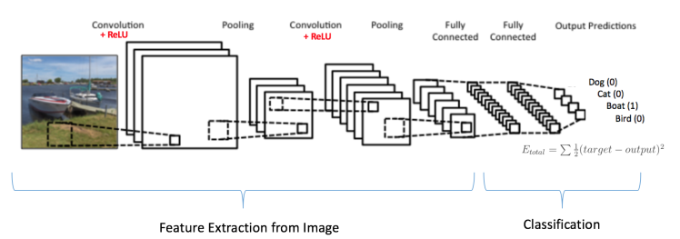
Convolutional Neural Networks
https://ujjwalkarn.me/2016/08/11/intuitive-explanation-convnets/
Notes:
Similar to MLP, but uses convolution layers
The filter is moved across the grid and produces new values. These new values can represent edges or lines in the image.
Pooling layers do what they sound like. They “pool” together the most important characteristics found by the filters. This is done by using multiple methods. One popular method is Max Pooling, where for each filtered part of an image, the largest number is taken and stored into a new grid
Fully connected vs conv for mnists dataset

Slide 6

Transfer Learning
A pre-trained model is used as the starting point for another “related” task
You can fine-tune a pre-trained model from
a model zoo (VGG, ReseNet, BERT, etc)
Notes:
A model developed for a task is reused as the starting point for a model on a second task
Deep learning models excel at learning from a large number of labeled examples, but typically do not generalize to conditions not seen during training.
successful models are immensely data-hungry and rely on huge amounts of labeled data to achieve their performance.
Different scenarios:
The feature spaces of the source and target domain are different, e.g. the documents are written in two different languages.
The marginal probability distributions of source and target domain are different, e.g. the documents discuss different topics. This scenario is generally known as domain adaptation.
The label spaces between the two tasks are different, e.g. documents need to be assigned different labels in the target task.
he conditional probability distributions of the source and target tasks are different, e.g. source and target documents are unbalanced with regard to their classes.

Slide 7
Questions?

